Slide 1



Slide 2


Slide 3


Slide 4
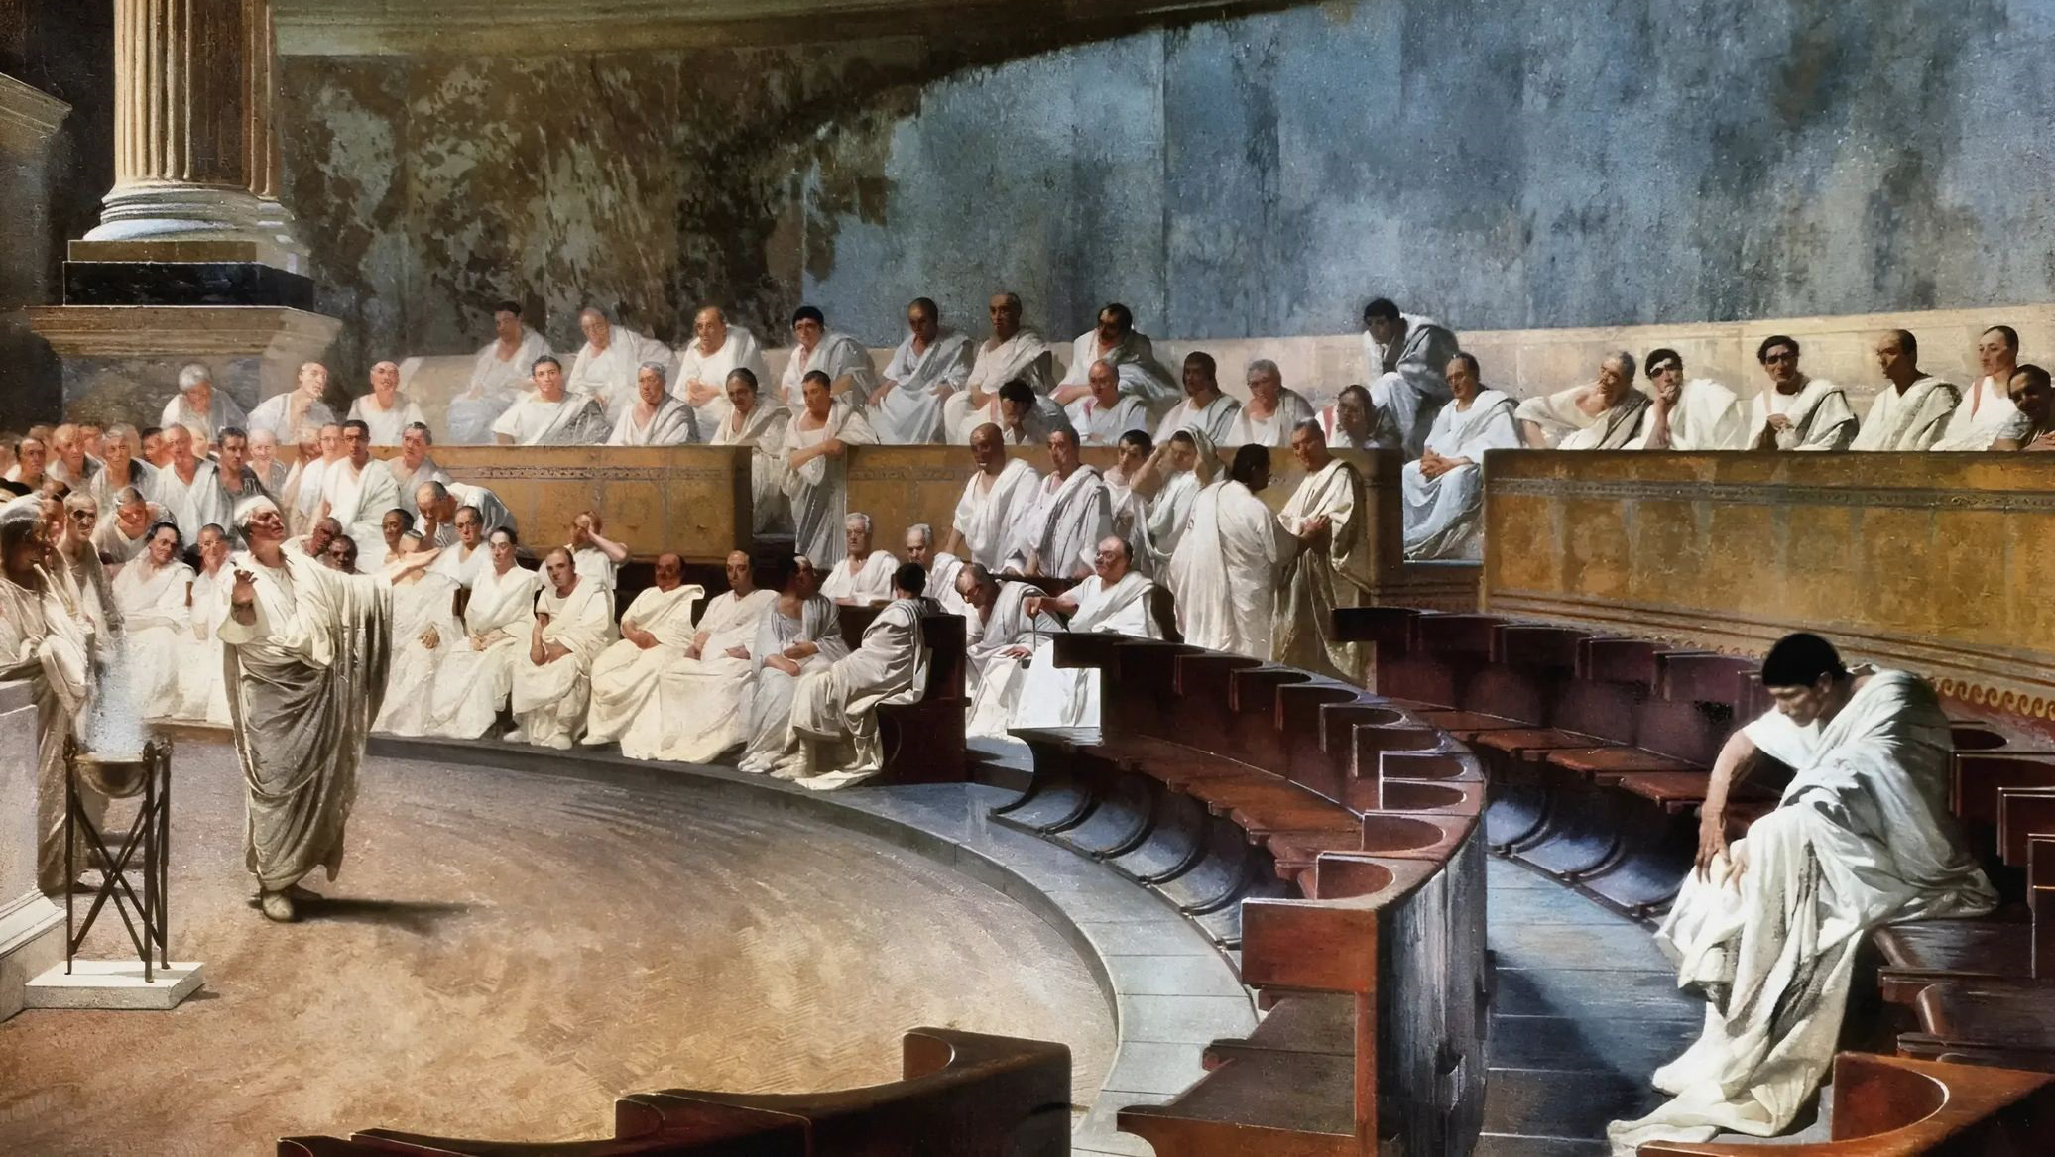

Slide 5
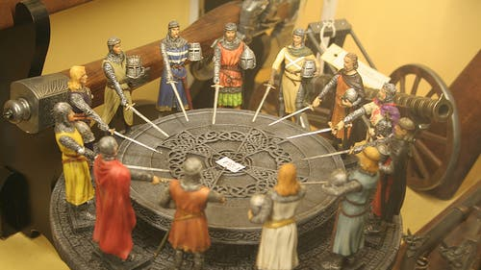

Slide 6
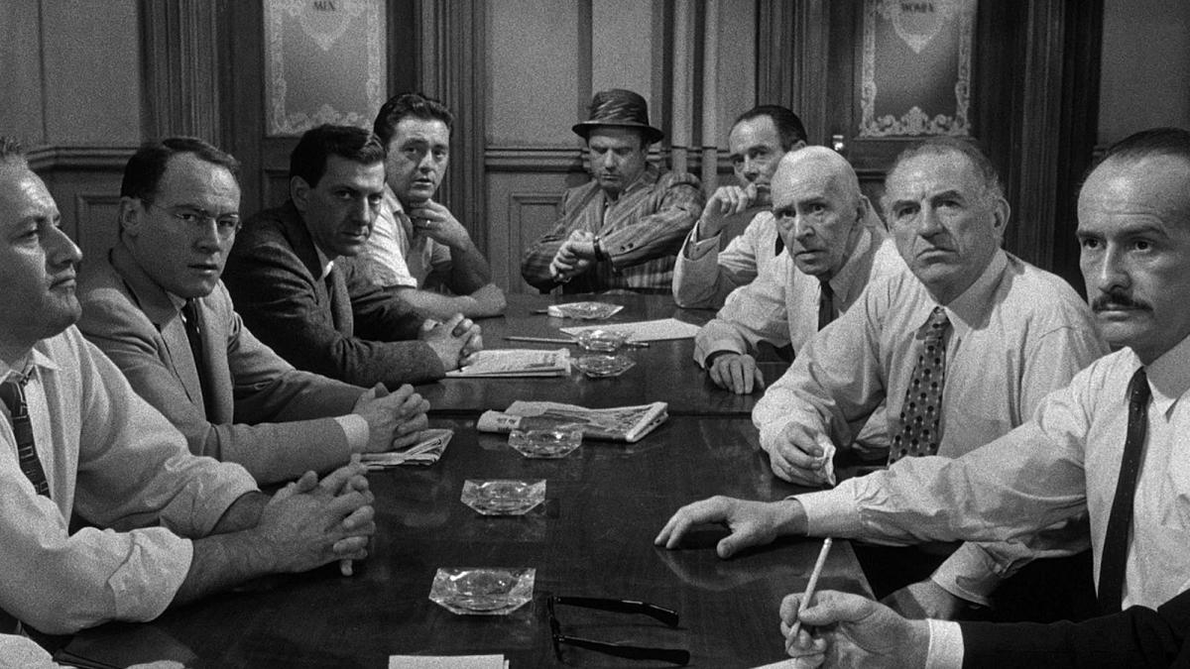

Slide 7
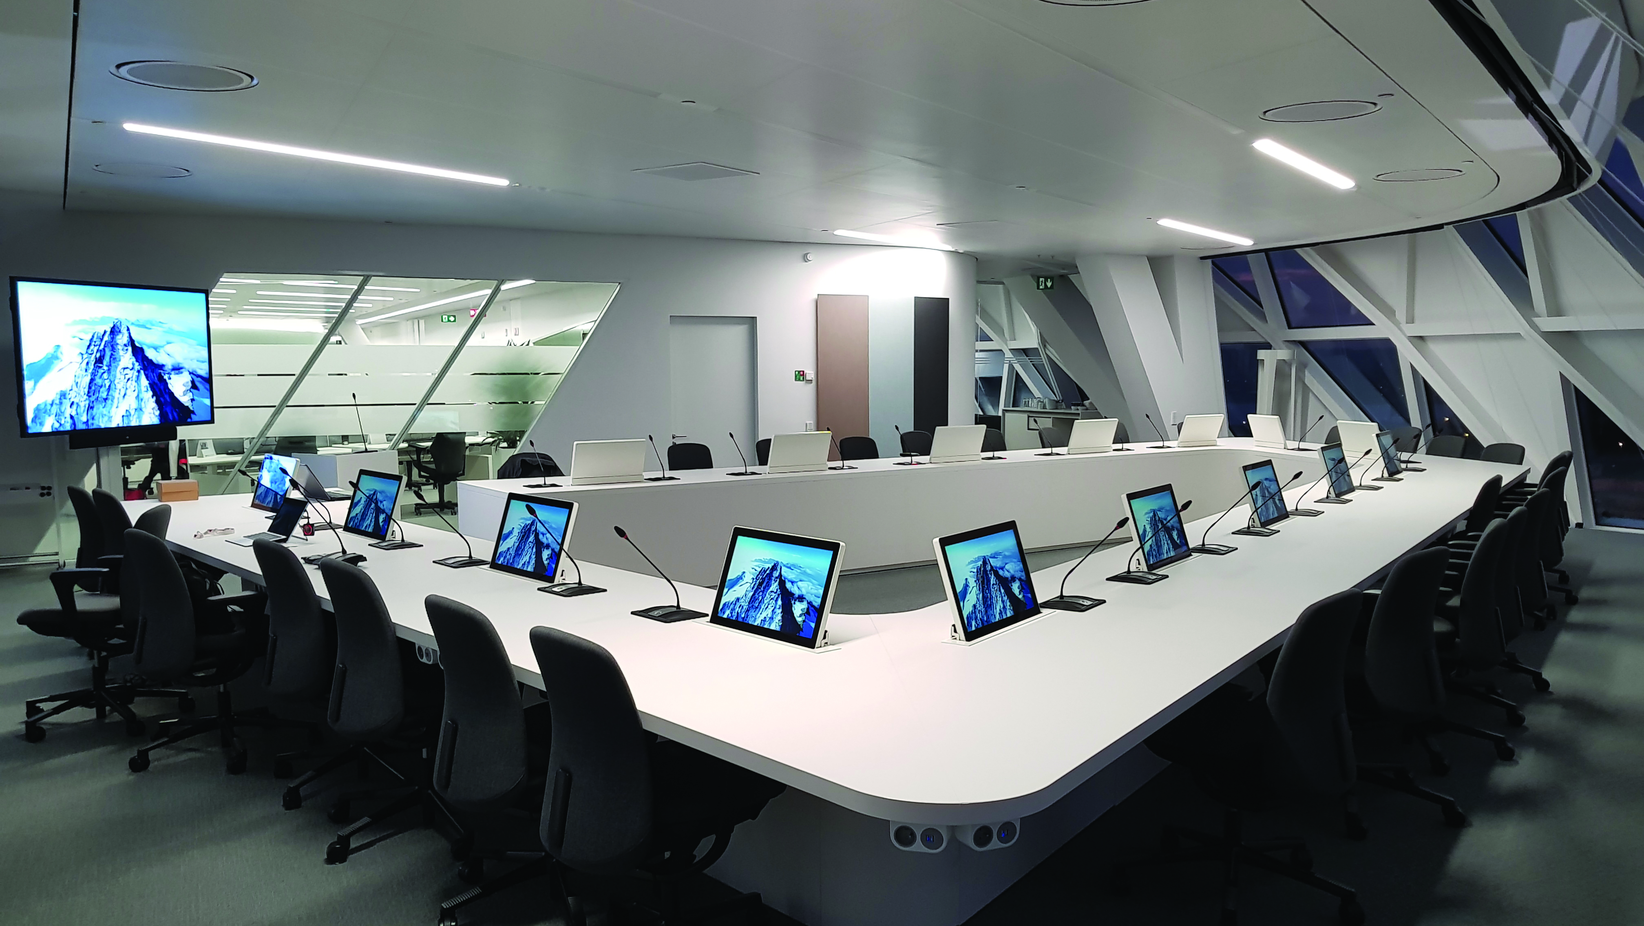

Slide 8
We are likely to see profound impacts from AI—auto-transcription of meetings, annotated minutes, action-item trackers, and sentiment-analysis reports—all feeding back into space design and usage strategies.
Embrace flexibility
Invest in technology
Invest in sustainability
Use data
Prioritize wellbeing
Stay agile
Personalize the boardroom and the meeting room

Slide 9
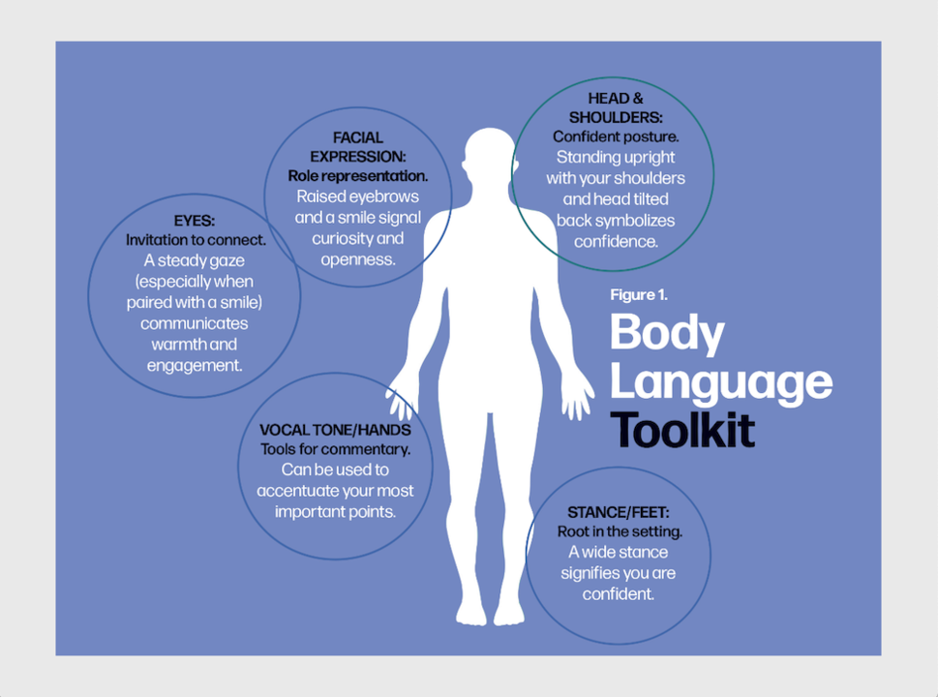
The importance of non verbal communication

Slide 10
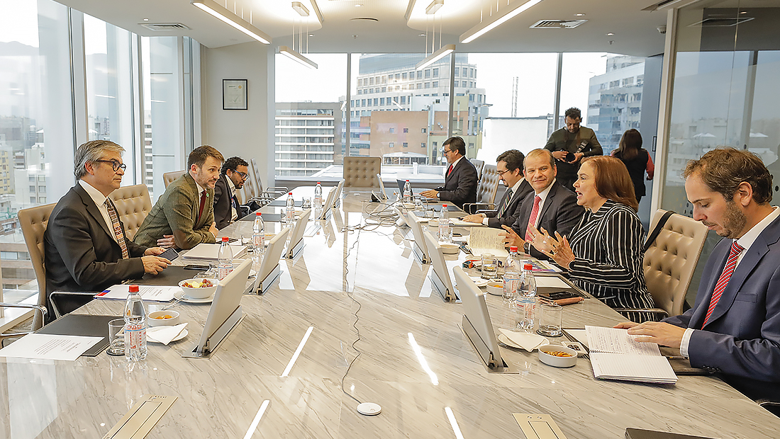

Slide 11
The eyes are the window to the soul
Establishes bonds and rapport with others
Help build trust
Improve understanding between teams
Making eye contact is a sign of respect
Enhances authority and influence

