Slide 1
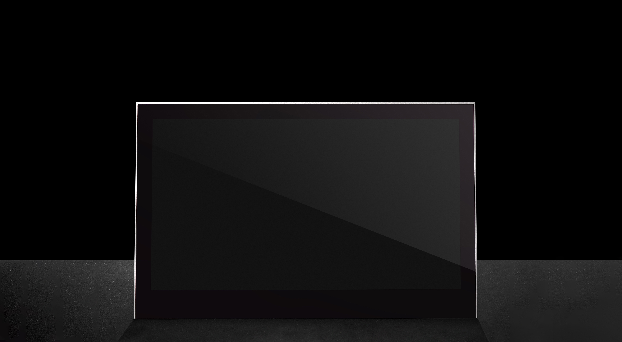


Slide 2
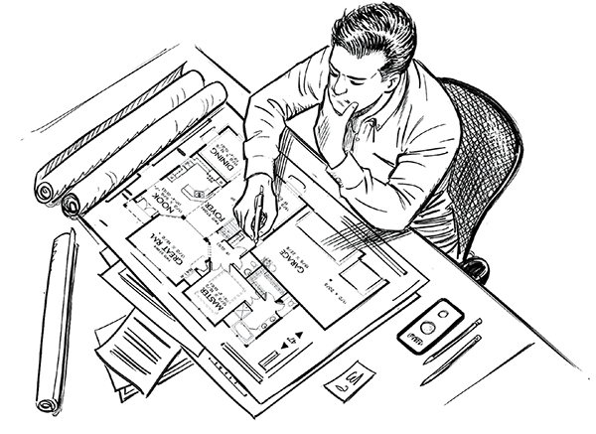
Neuroarchitecture & The Pshycology of Meeting Table Design
What is NeuroArchitecture?
Merges Neuroscience and Architecture
Studies How Space affects the Brain
Key concerns: Comfort, Stress, Cognition, Behaviour

Slide 3
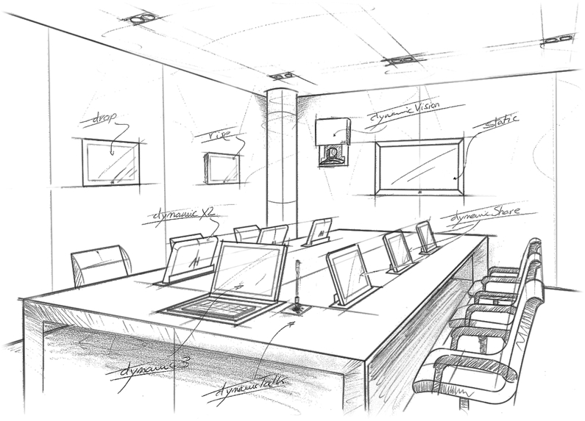
Key Psycological Principles in Meeting Spaces
Proxemics (personal space)
Sightlines and eye contact
Spatial hierarchy and power perception
Sensory processing (light, material, acoustics)

Slide 4
Table Shape & Group Dynamics
Rectangular: Hierarchical, structured
Encourage formality and hierarchy
Leaders typically positioned at the head, directing conversation flow

Slide 5
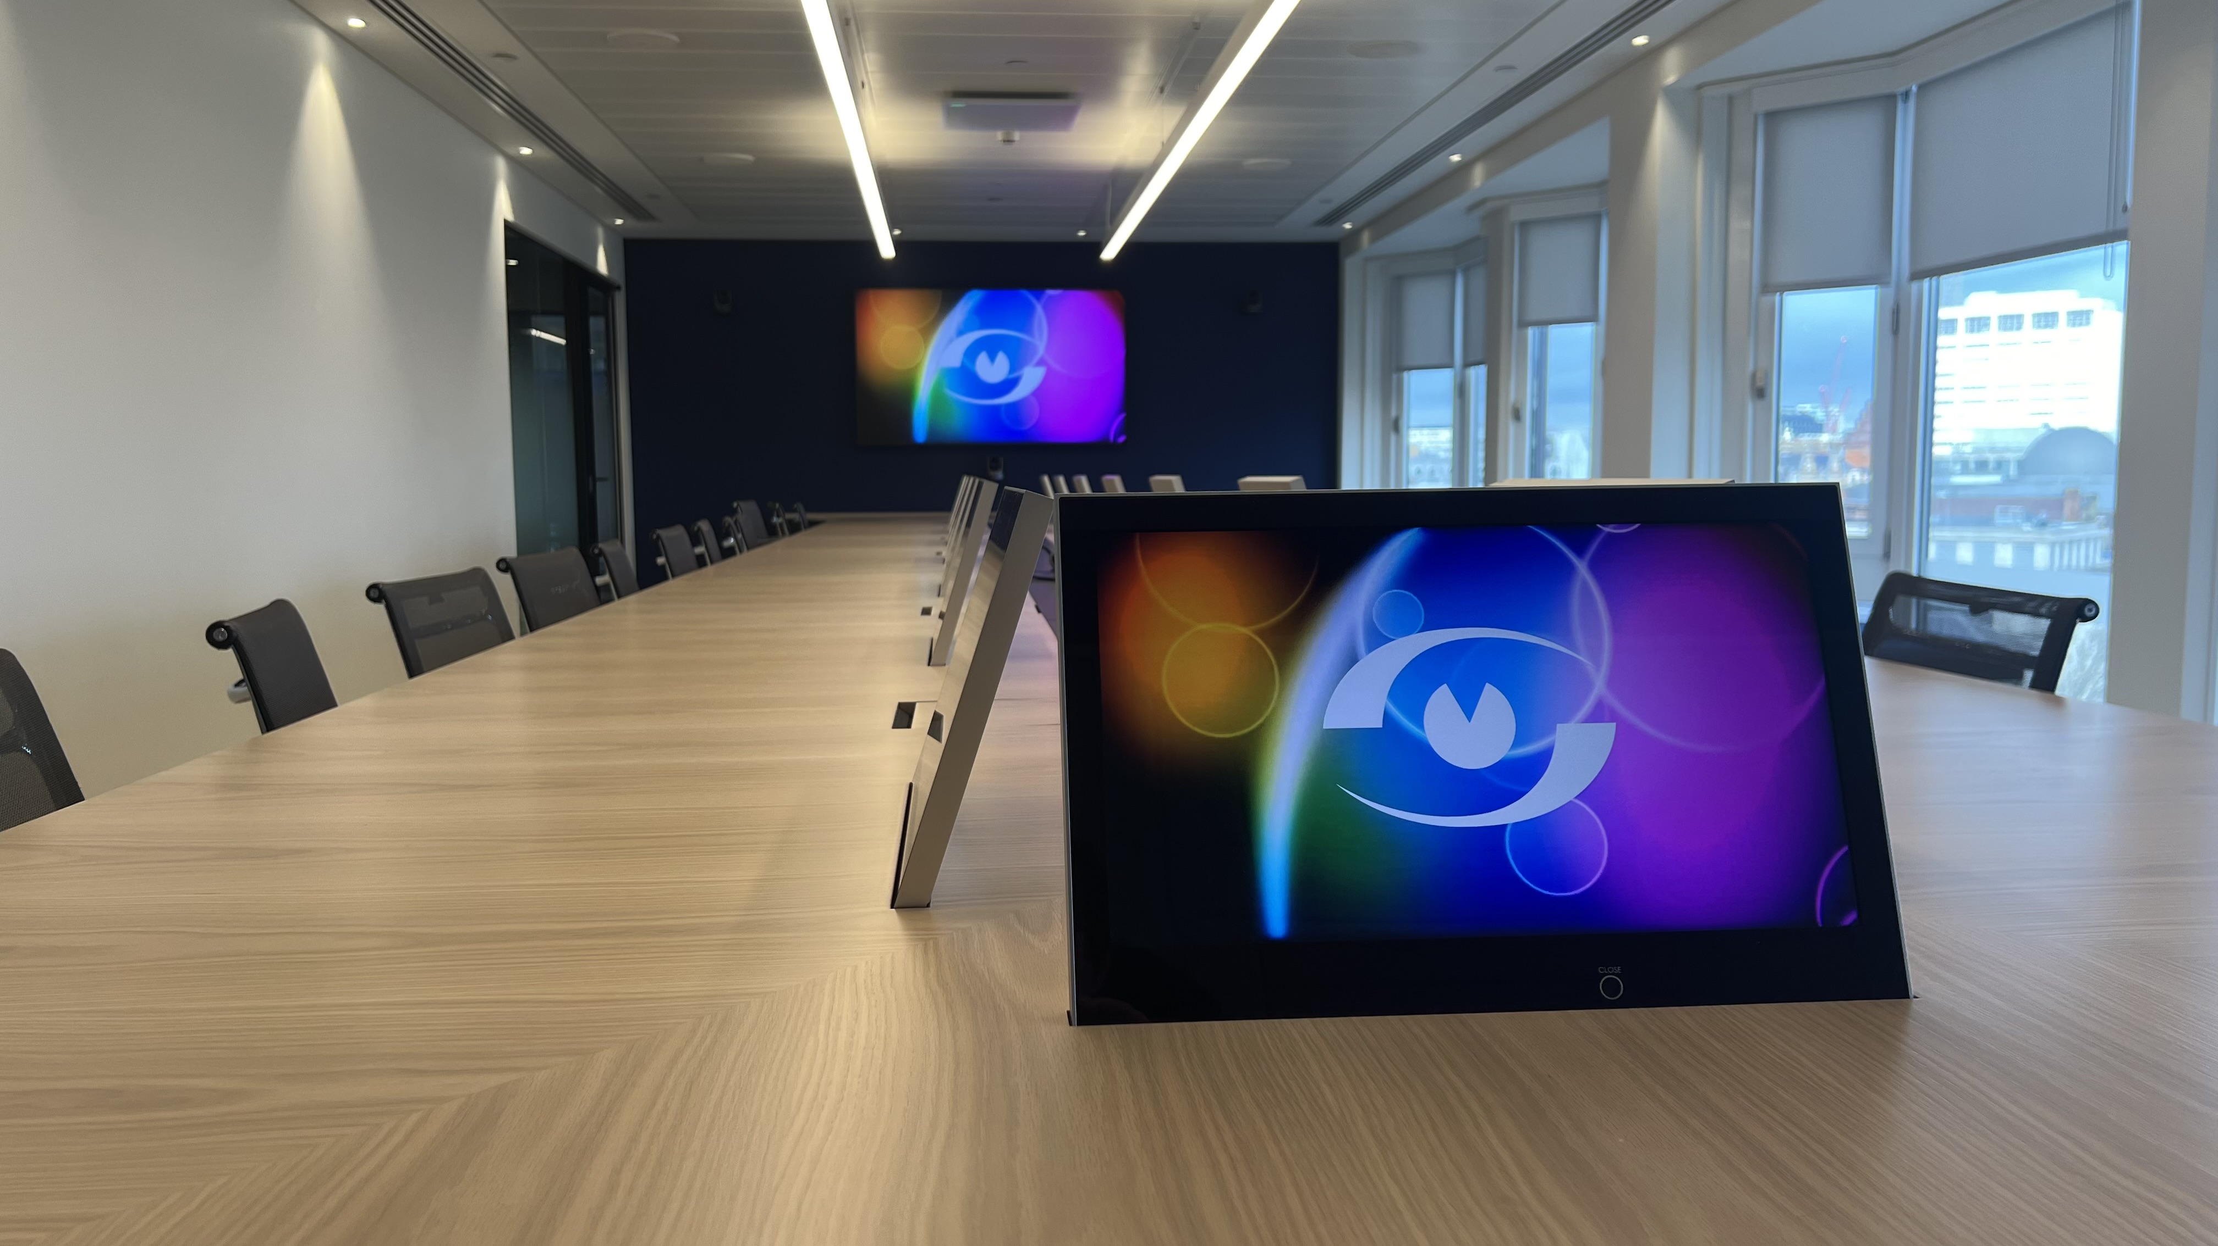

Slide 6
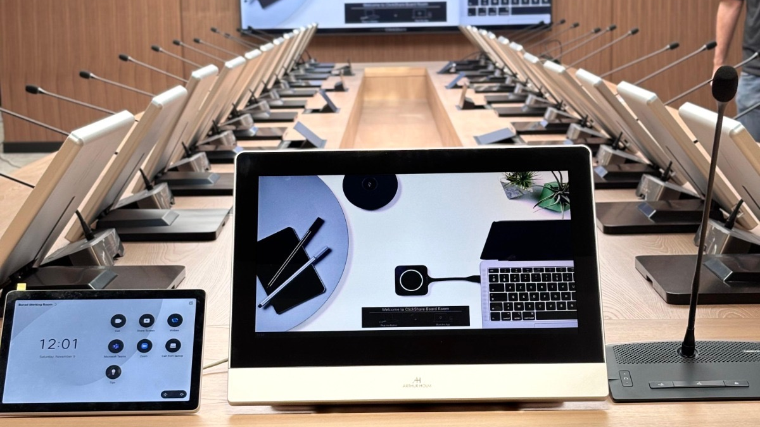

Slide 7
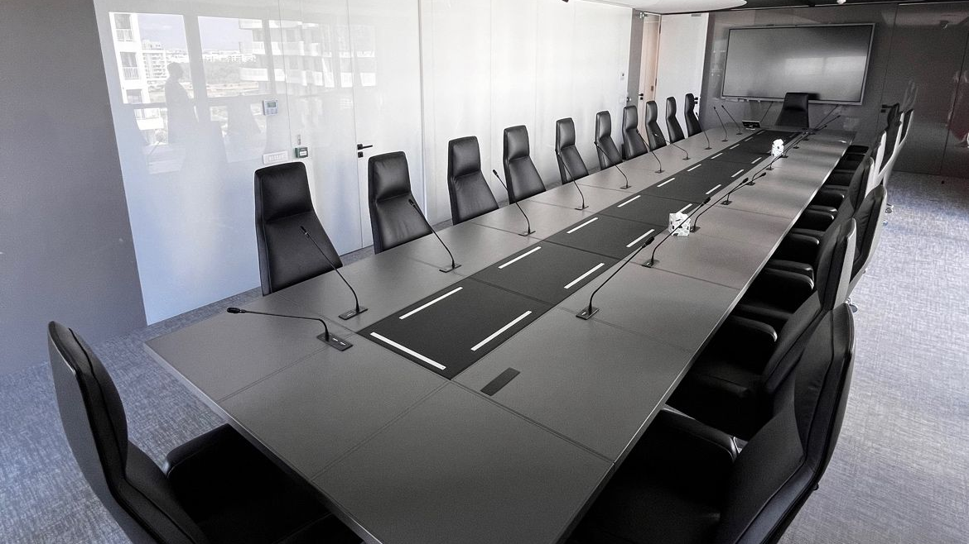

Slide 8
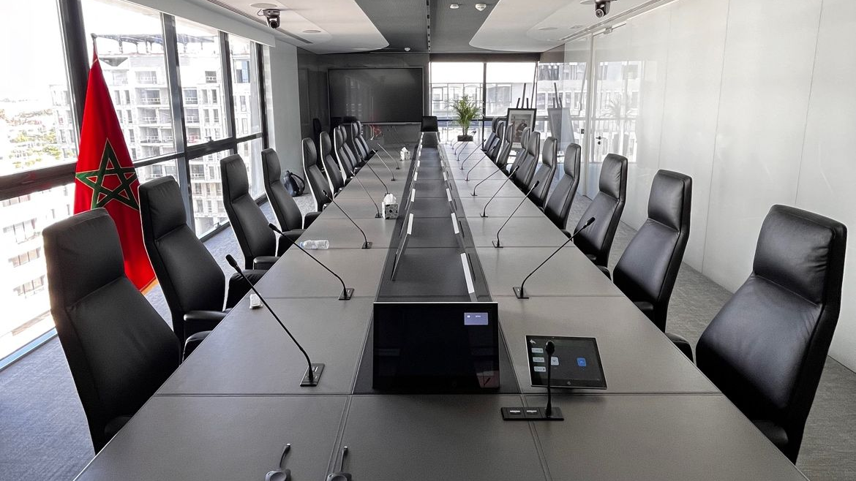

Slide 9
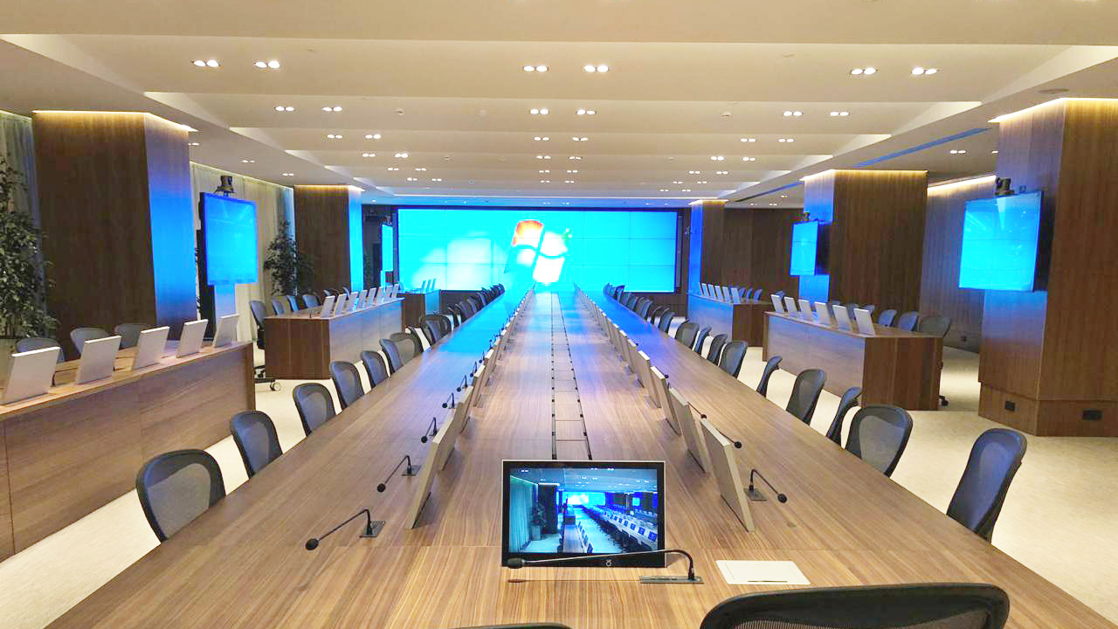

Slide 10
Table Shape & Group Dynamics
Round: Egalitarian, Collaborative
Promote Inclusivity and Equality
Fosters unity and Collaboration
Encoourages Open and Fair discussions

Slide 11
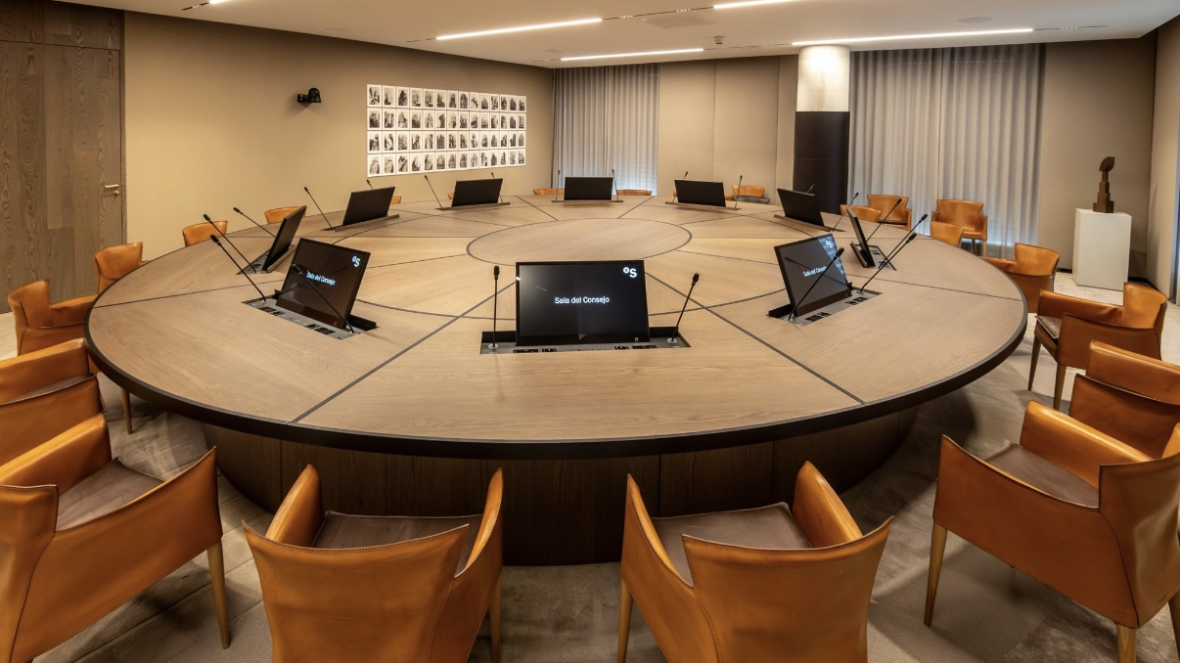

Slide 12
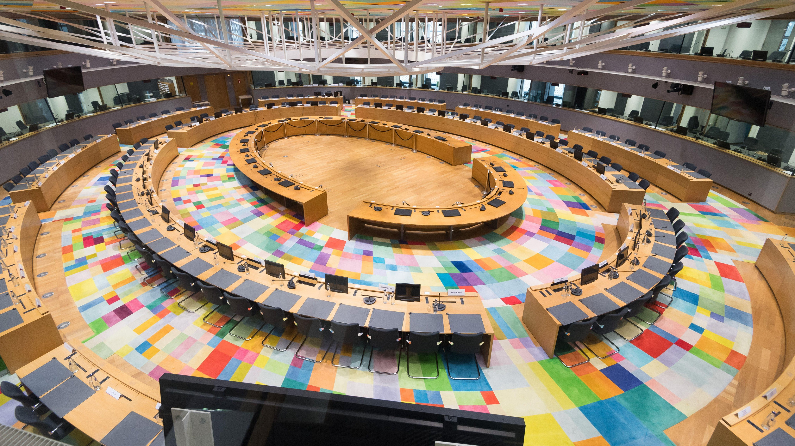

Slide 13


Slide 14


Slide 15
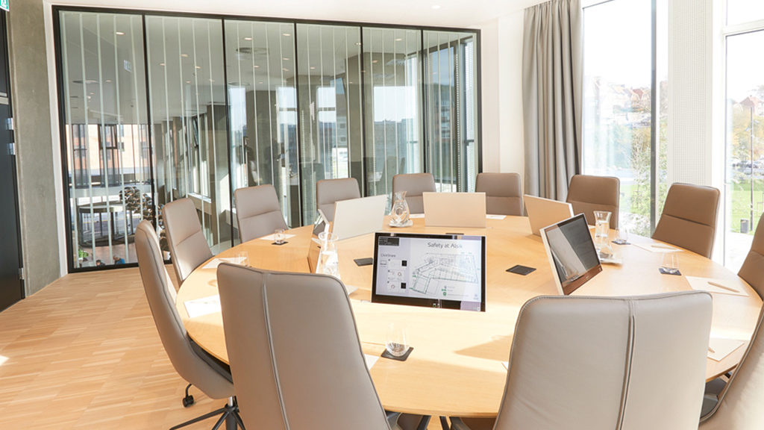

Slide 16
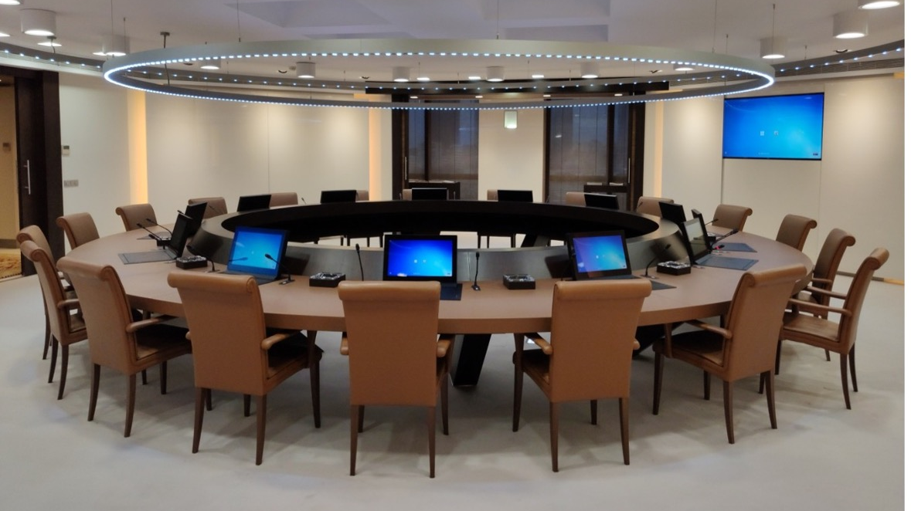

Slide 17
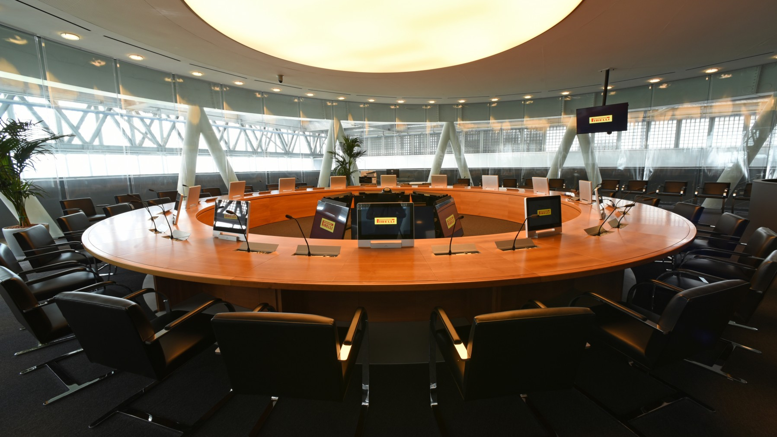

Slide 18
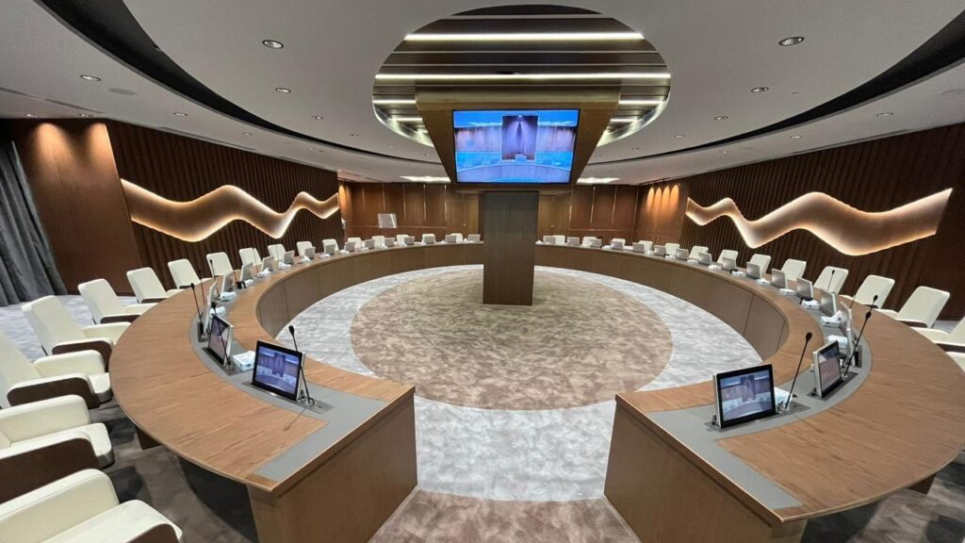

Slide 19
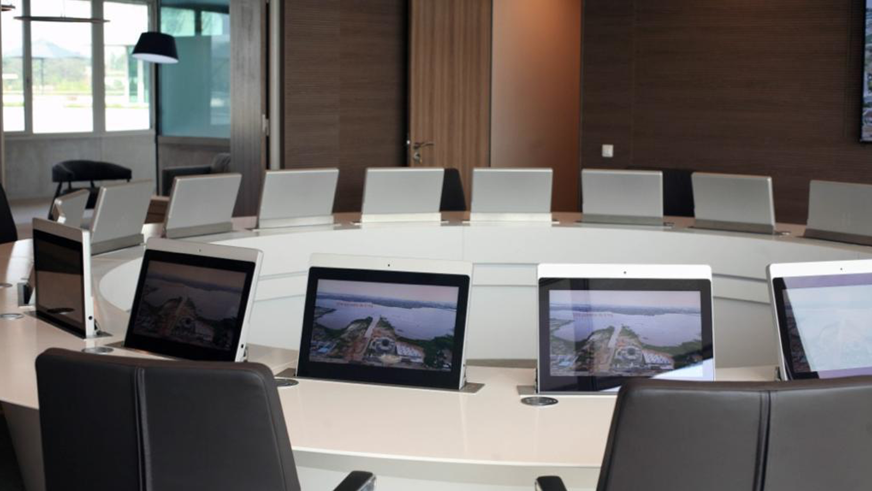

Slide 20
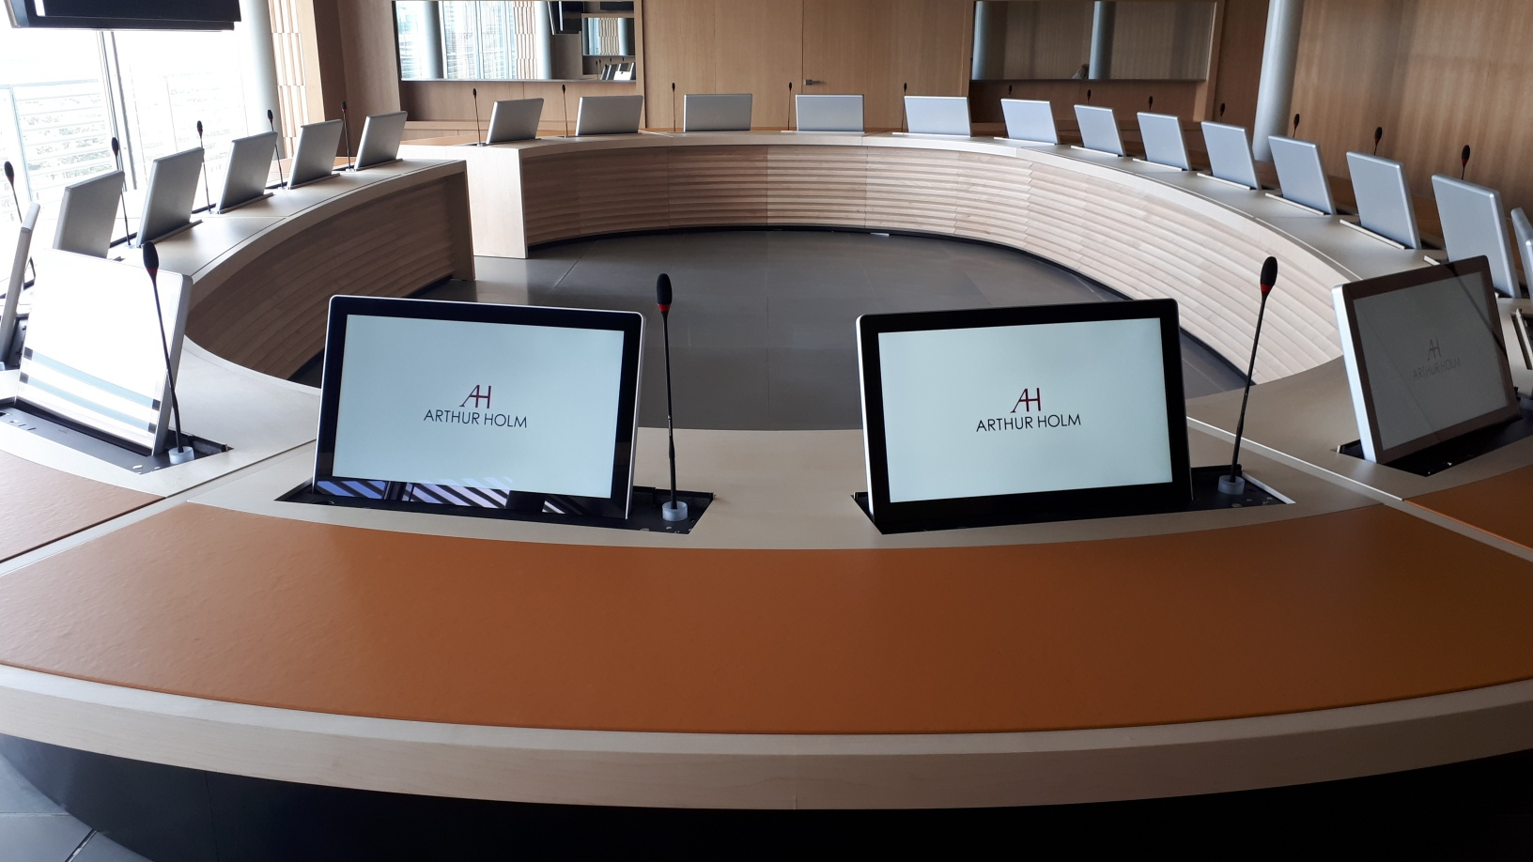

Slide 21
Table Shape & Group Dynamics
Oval, U-Shaped or Horseshoe
A mix of Round and Rectangular
Balance between Structured Leadership and Group Discussion

Slide 22
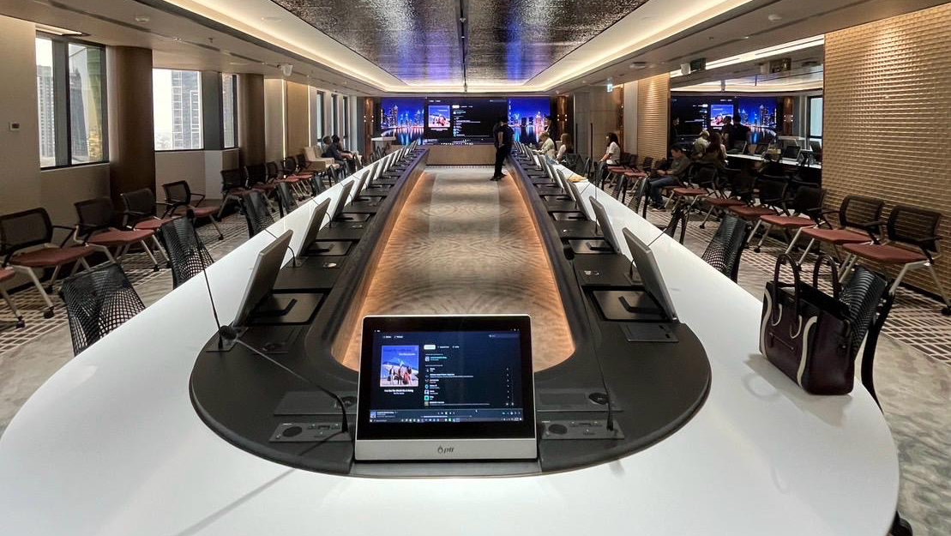

Slide 23
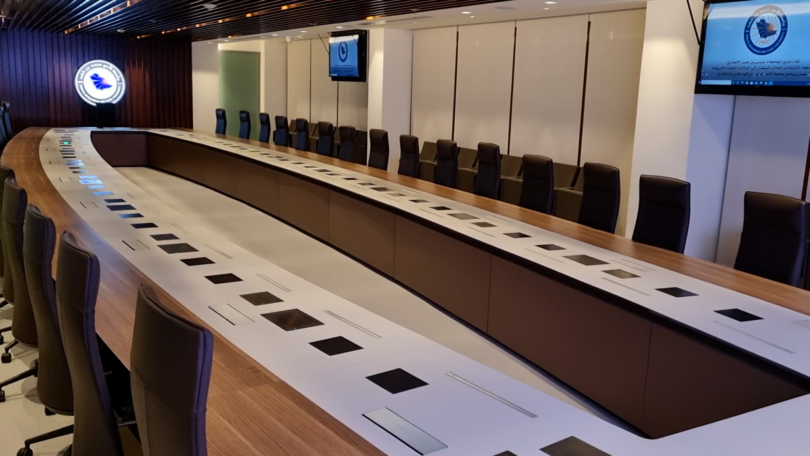

Slide 24
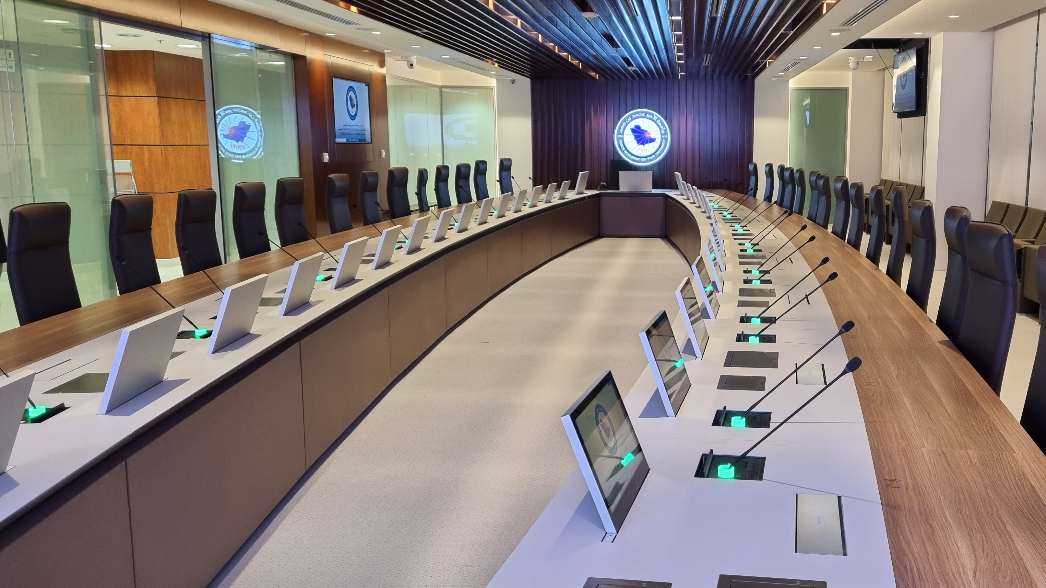

Slide 25
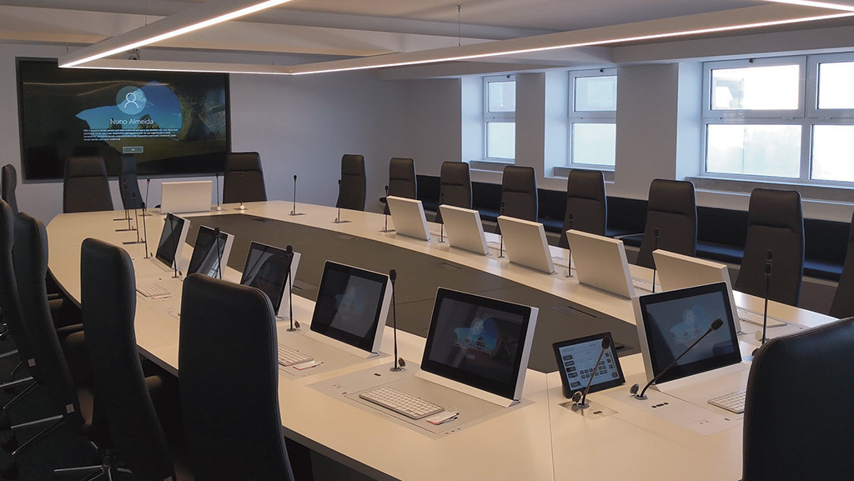

Slide 26
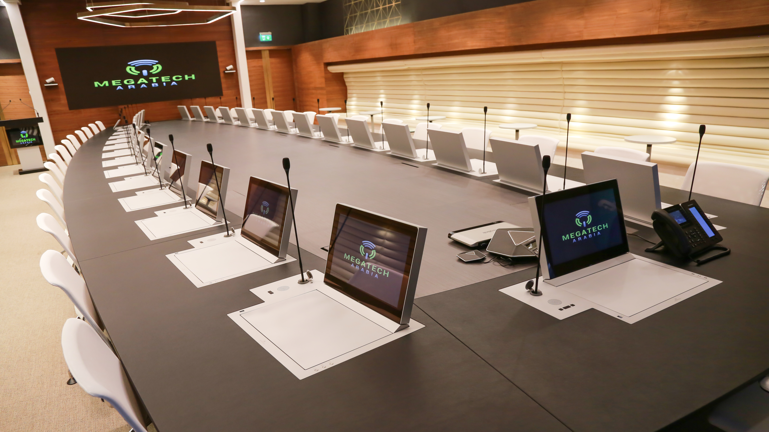

Slide 27
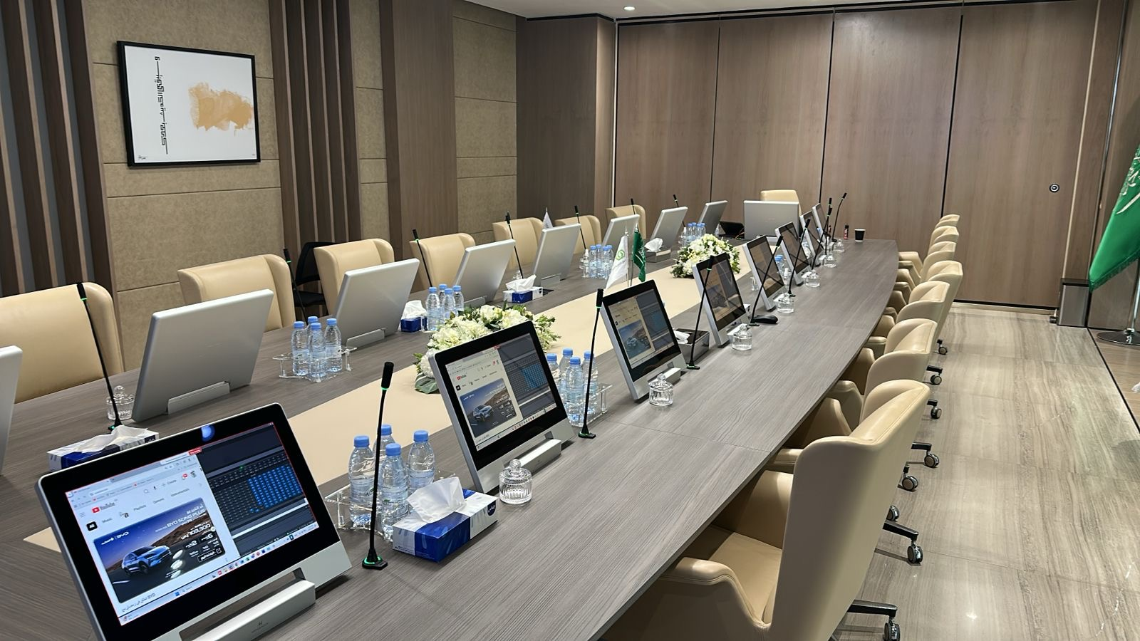

Slide 28
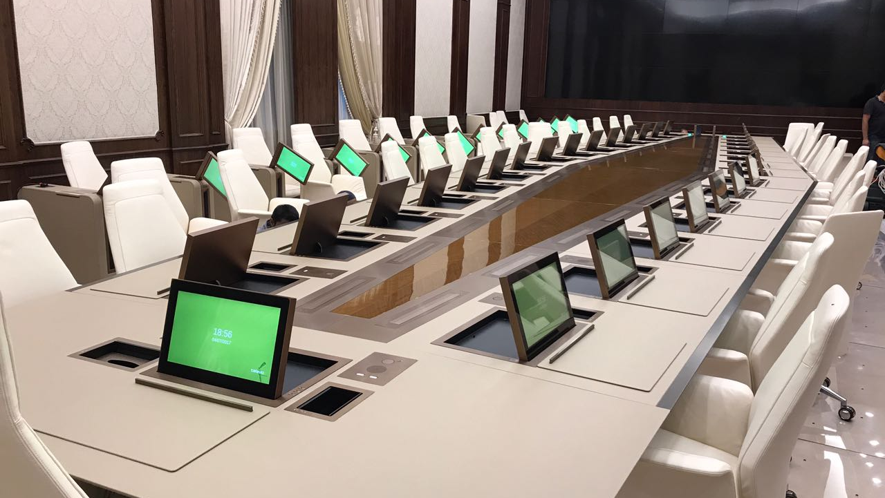

Slide 29
Table Shape & Group Dynamics
Modular Tables
Offer Flexibility
Allow configurations to adapt to different meeting needs

Slide 30
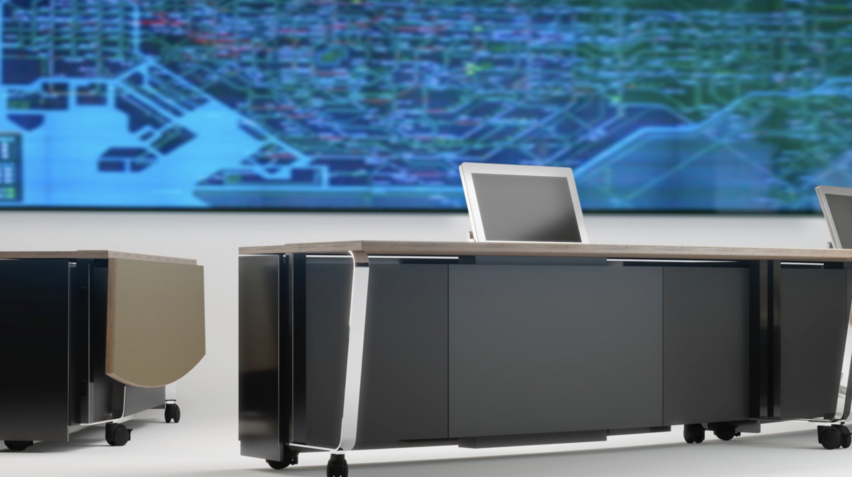

Slide 31
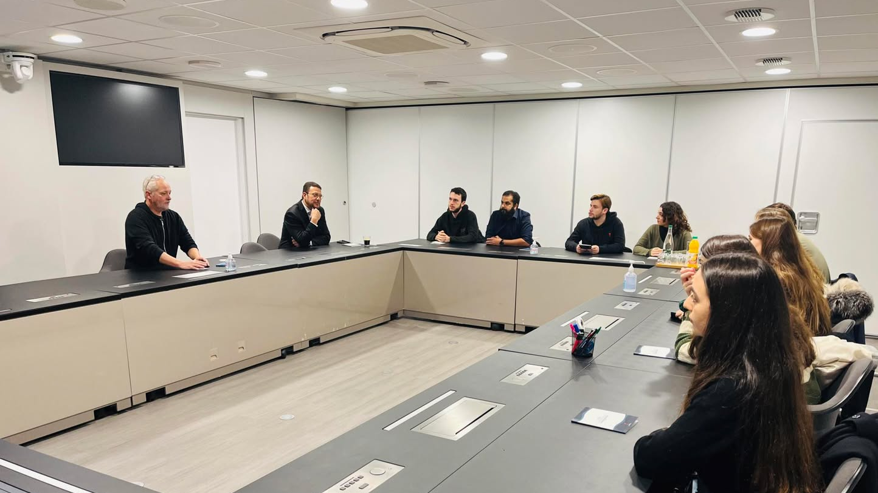

Slide 32
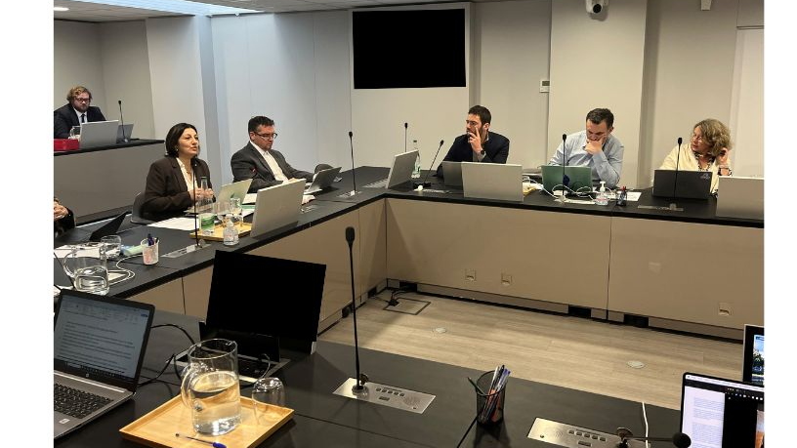

Slide 33
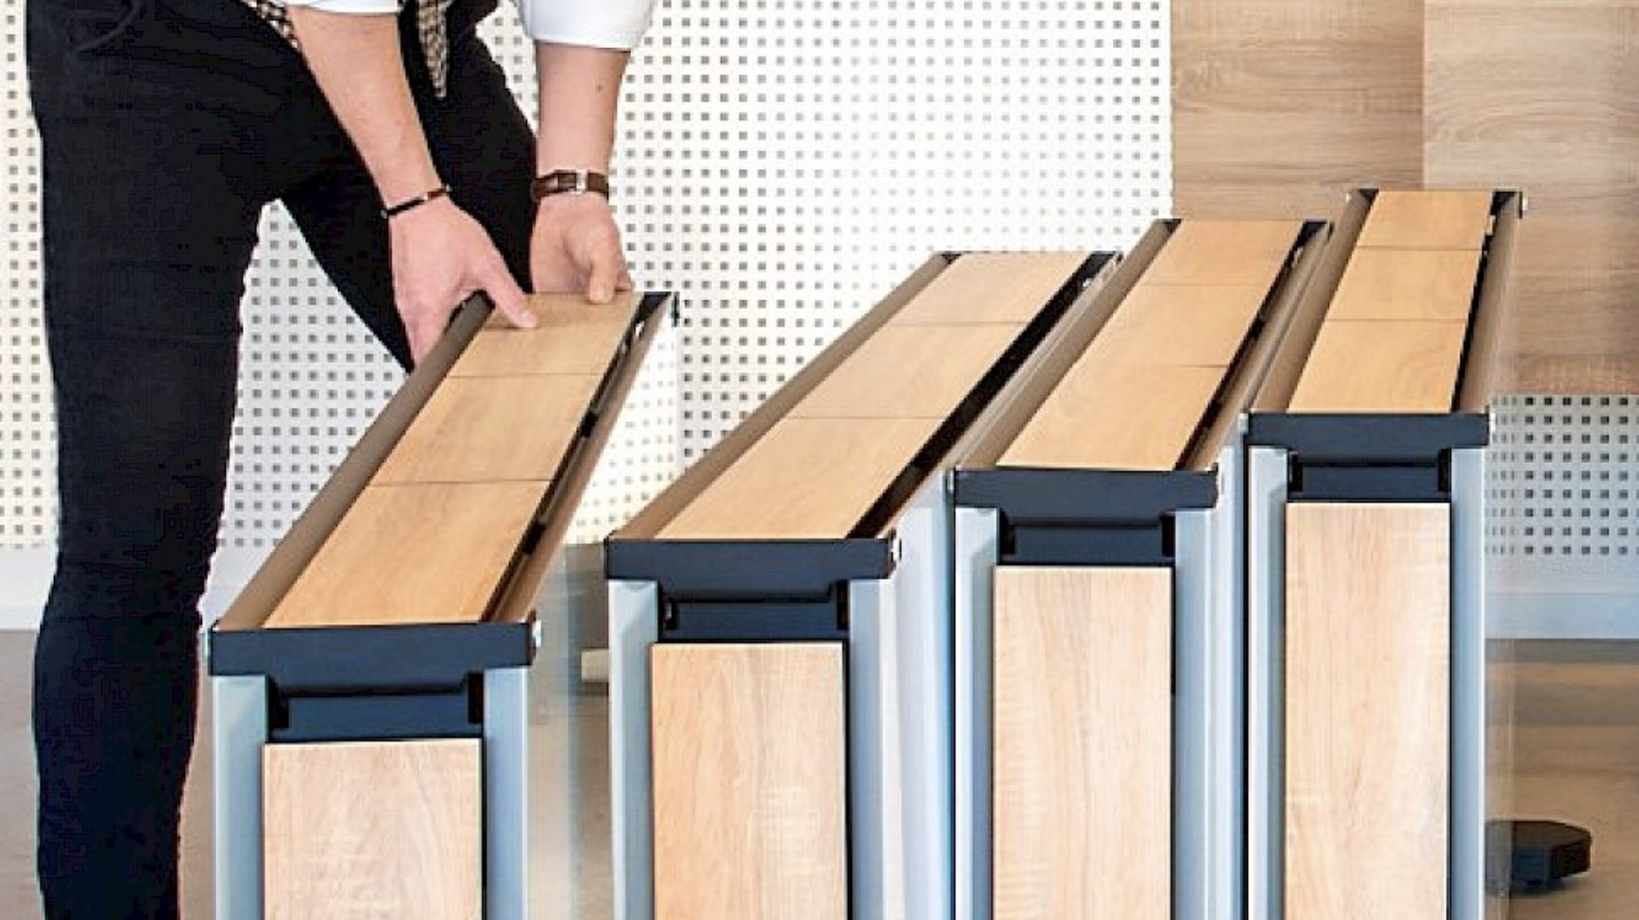

Slide 34
Table Materials & Group Dynamics
Sensory Influence of Materials
Wood: Warm, organic
Glass: Trasnparent, cold
Leather: Luxury, formal
Stone, marble, metal: Strong, formal

Slide 35
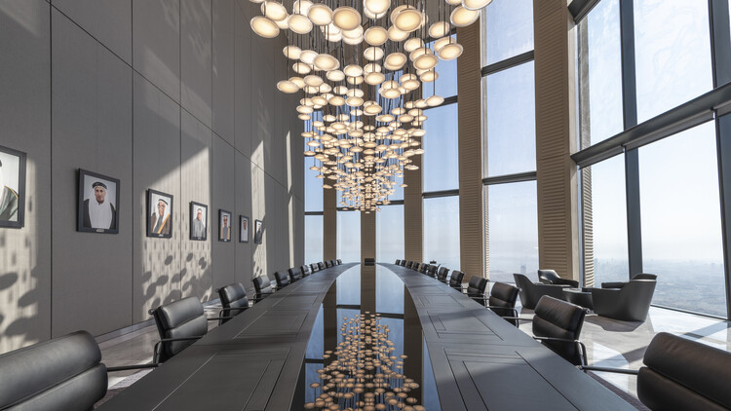

Slide 36
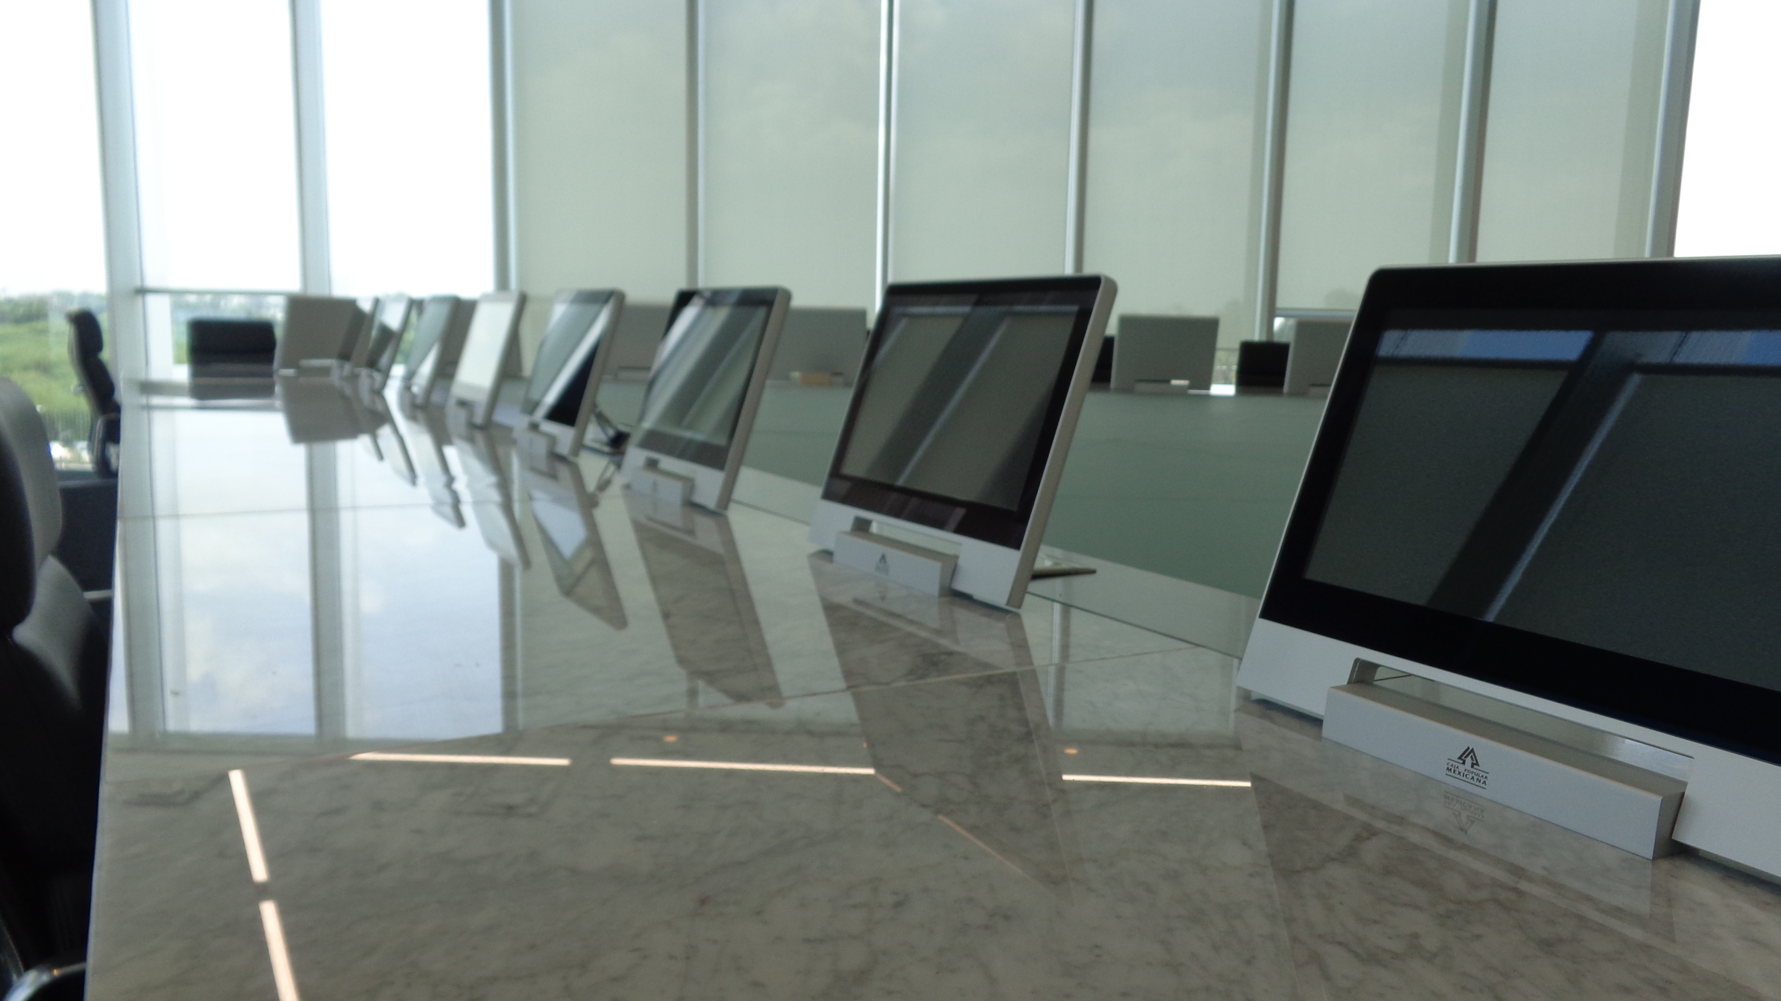

Slide 37
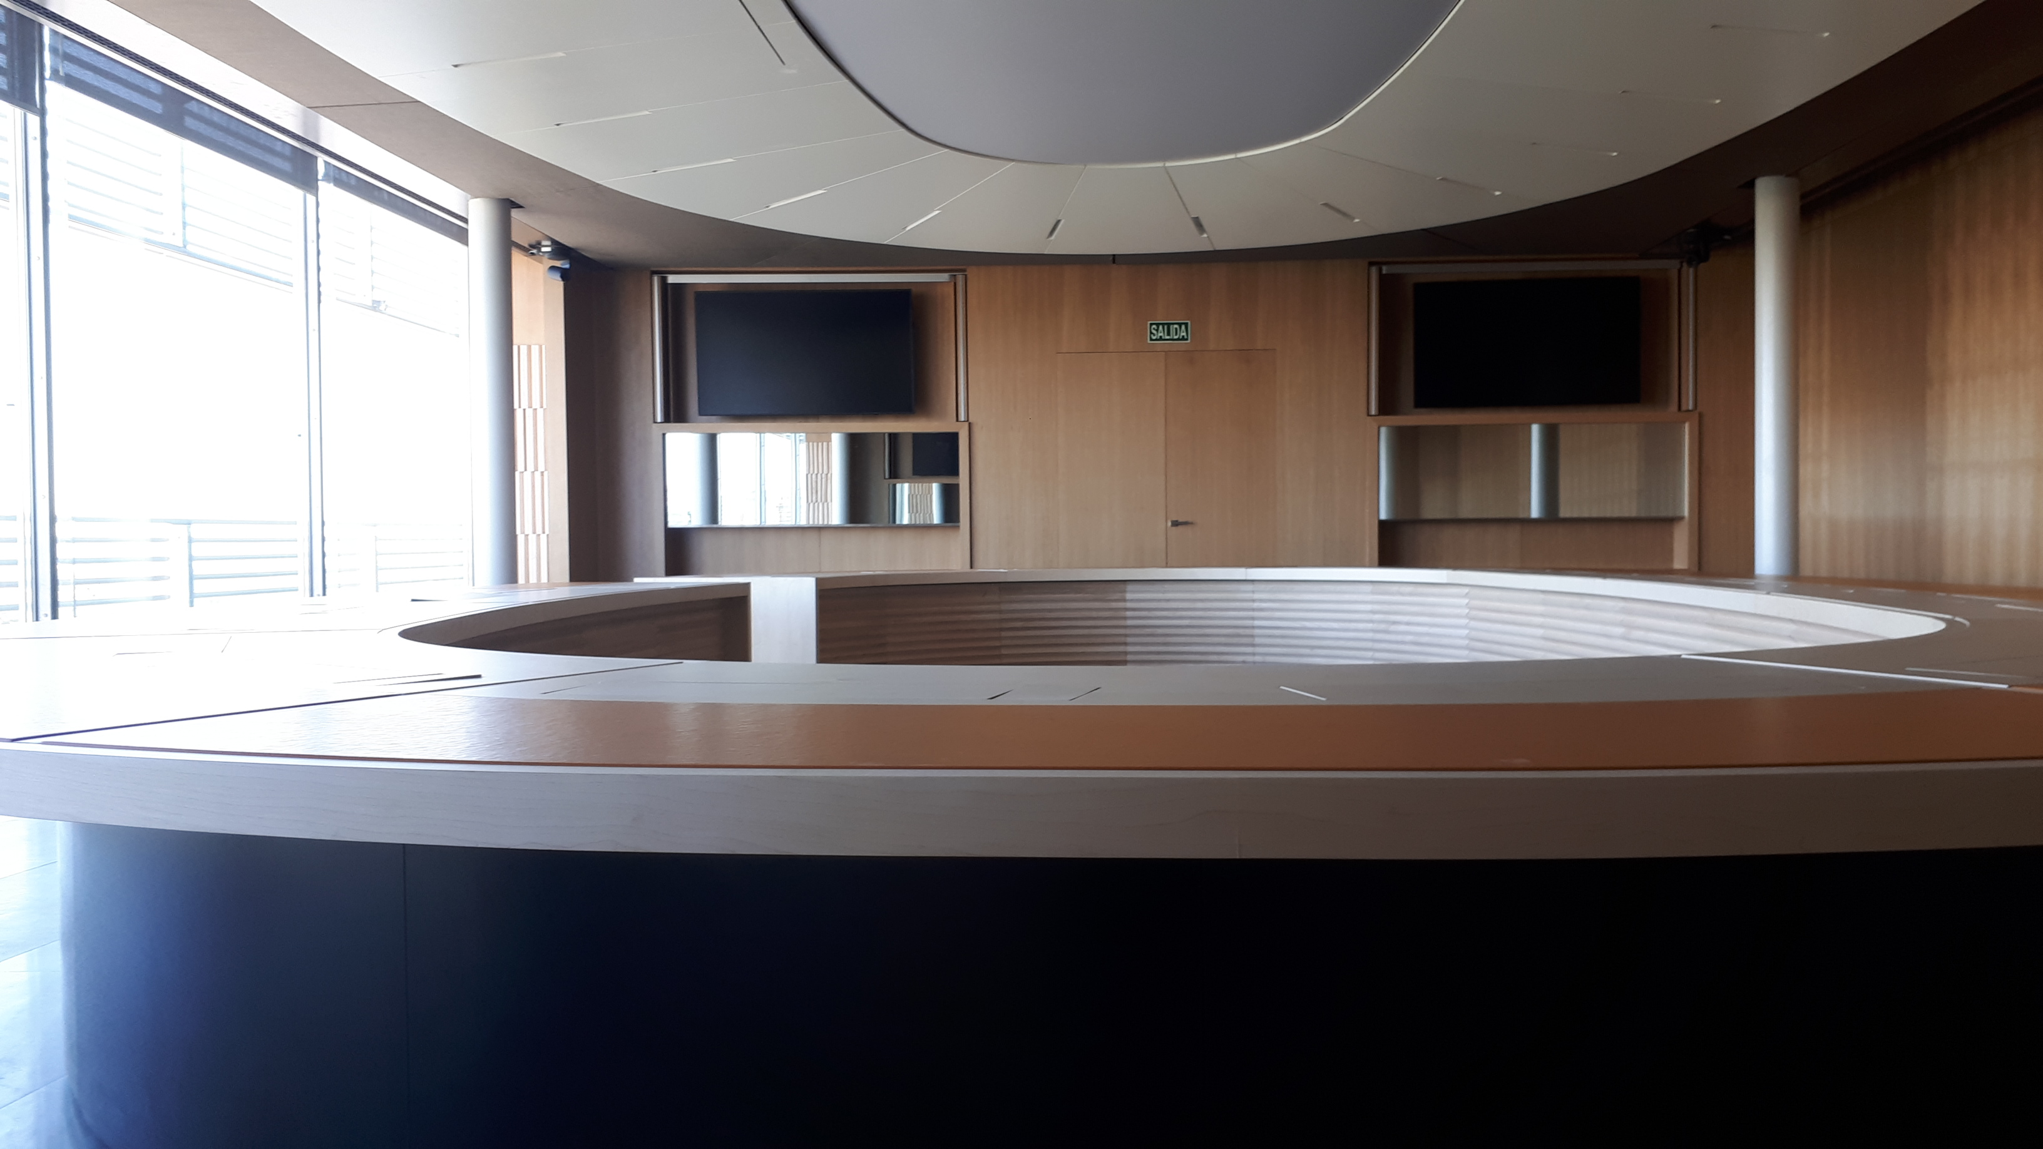

Slide 38
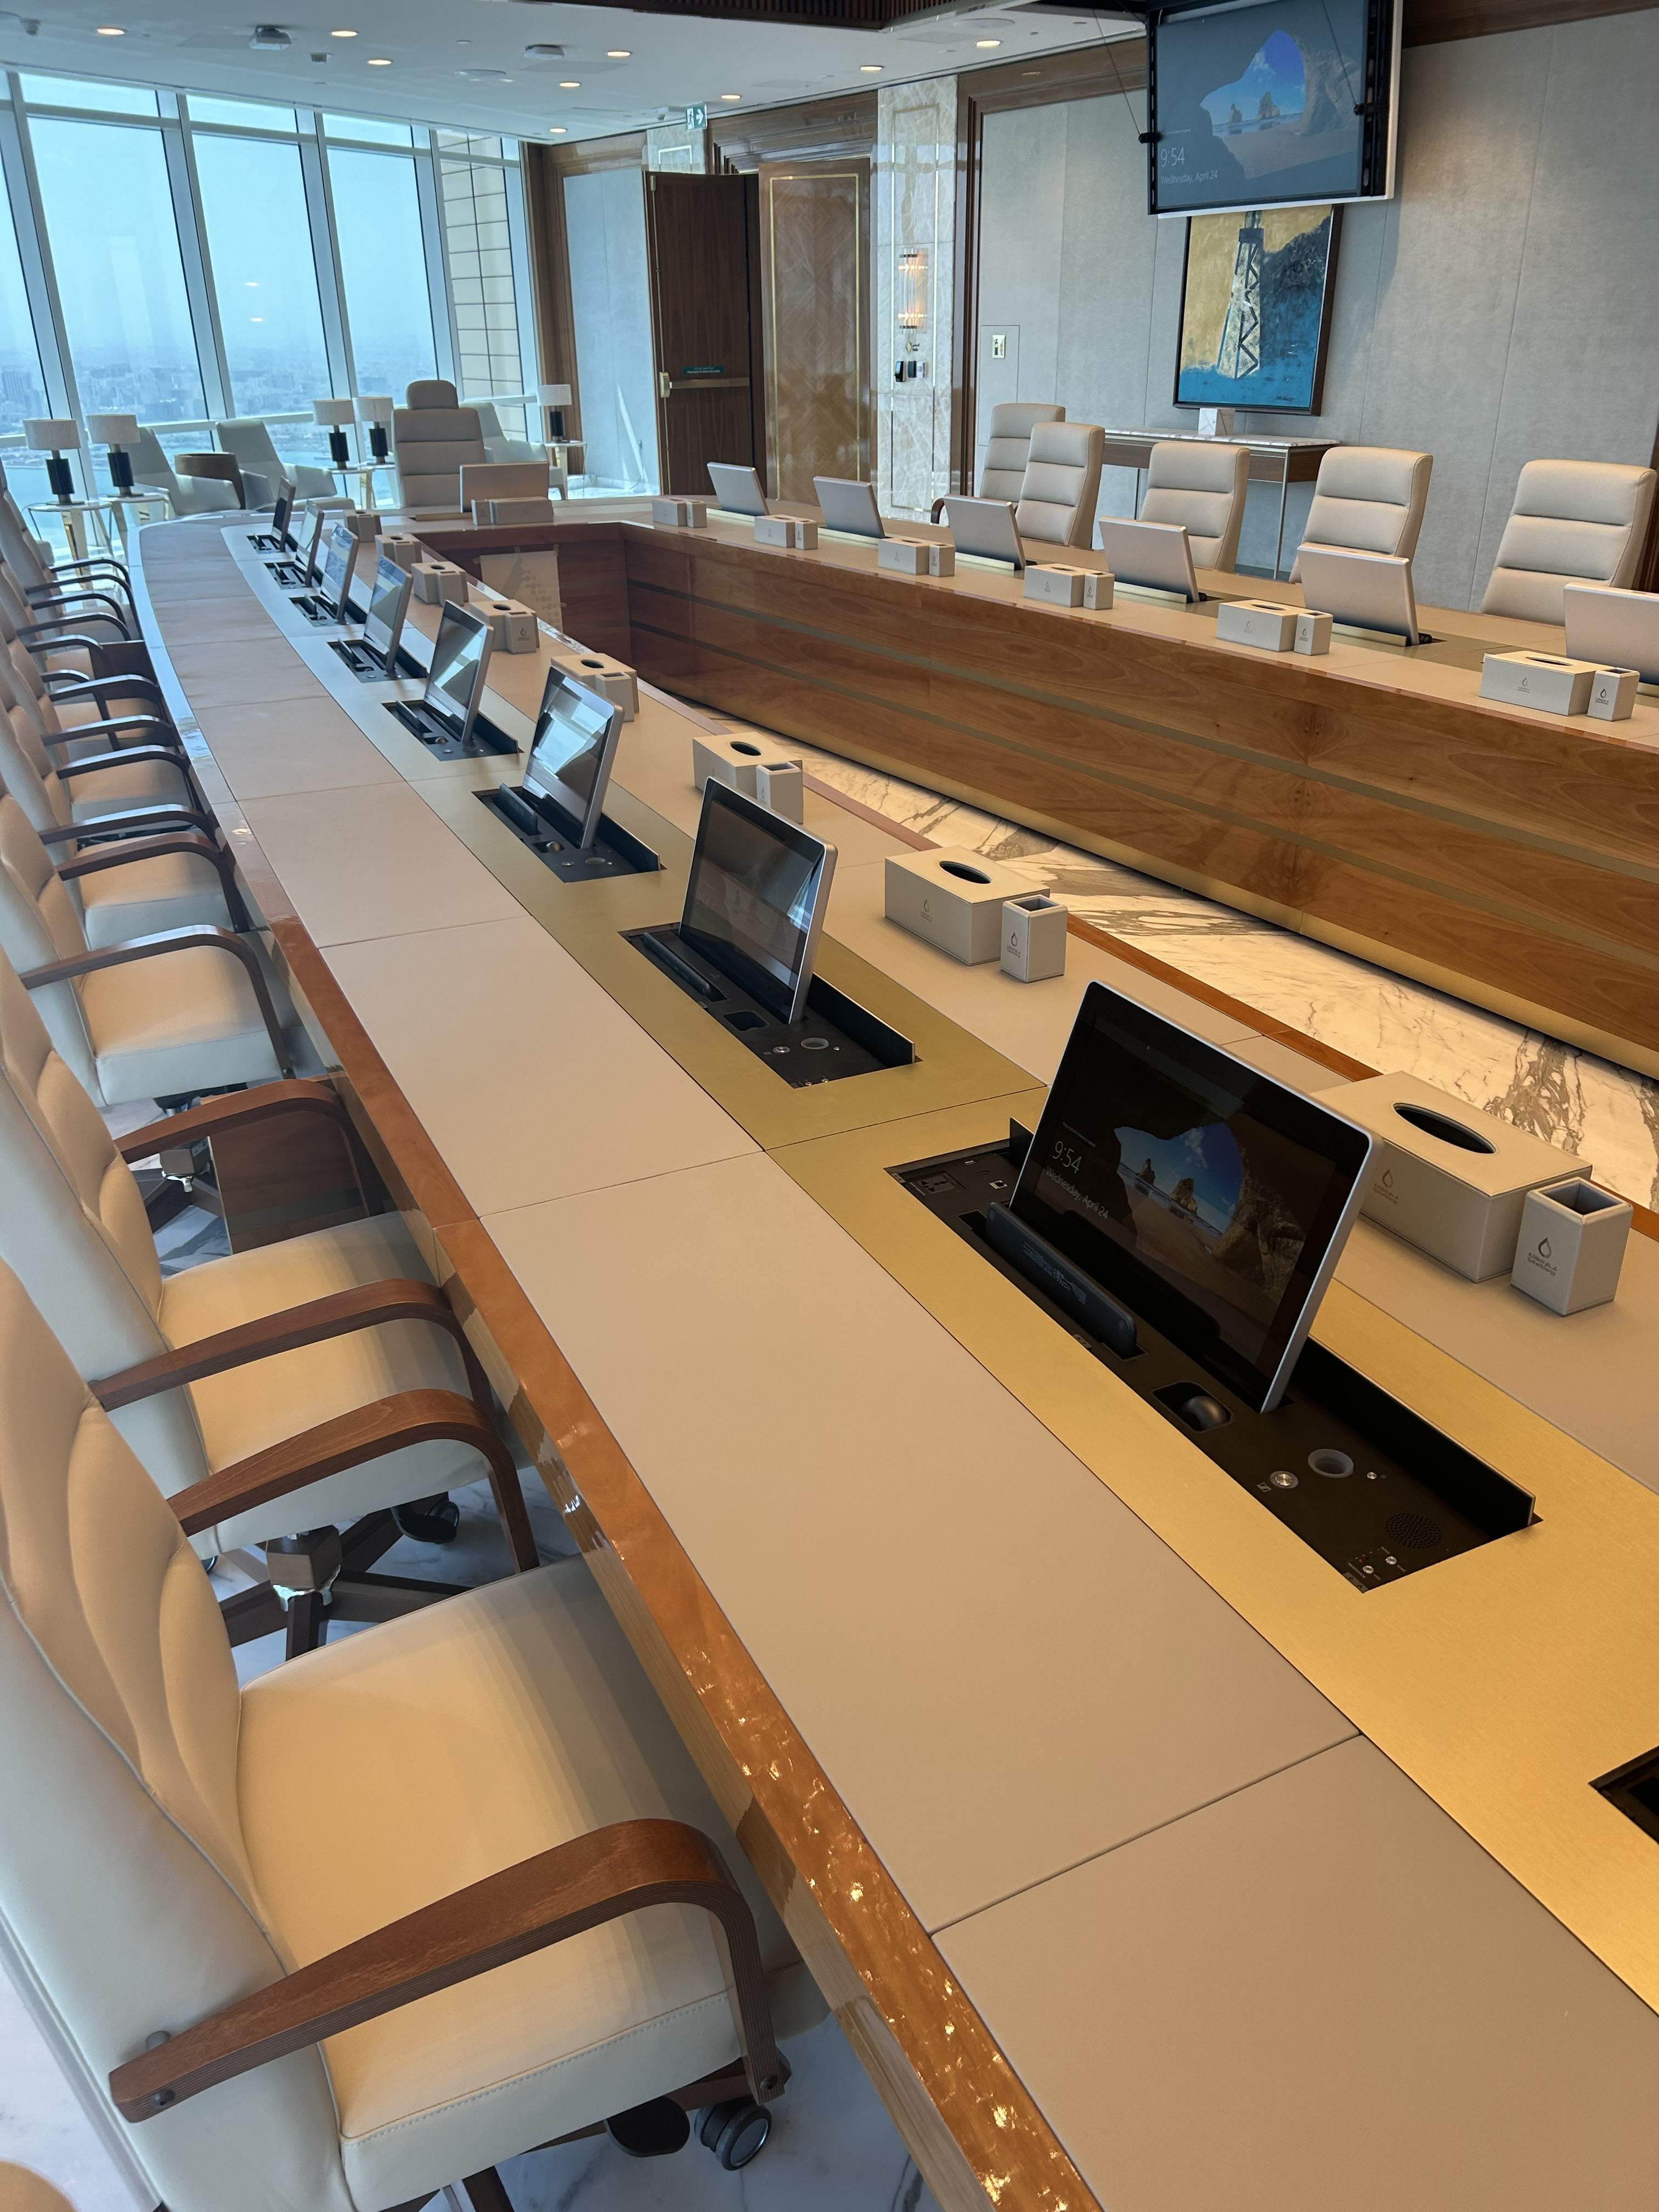

Slide 39
